Slide 1

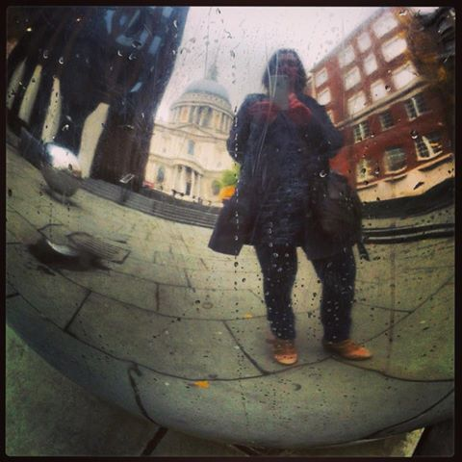
REFLEXIVE PHOTOGRAPHY AND VISUAL METHODS
Prof. Samantha Warren

Slide 2
Activity part 1:
15-20 mins: In pairs, take turns to interview each other about your photos
What is depicted, why was it chosen, composition, meaning? etc
Follow up on what you see as interesting – both in the photo and the photographers’ explanations
Be mindful of how the process unfolds as a research interaction (make notes on your observations/ reflections)

Slide 3
Basic methodology
Give participants a camera
Provide a brief, e.g., “show me how it feels to work here…”
Interview the participants about their images
Question motives, content, composition, what’s missing etc.
Printed or digital?
Can be adapted to use ‘found’ images, or researcher generated ones (elicitation)

Slide 4
Some starting points:
Photographs are assumed as ‘evidence’ in western culture (‘the realist tale’ Harper 2002)
Images are polysemic (multi-interpretations, multiple meanings)
Visual cultures/ assumptions revealed in conscious and unconscious framing, composition etc

Slide 5


Slide 6


Slide 7

Notes:
Of course not solely image here. The text anchors the meaning of the image.

Slide 8
Some starting points:
Photographs are assumed as ‘evidence’ in western culture (‘the realist tale’ Harper 2002)
Images are polysemic (multi-interpretations, multiple meanings)
Visual cultures/ assumptions revealed in conscious and unconscious framing, composition etc
Democracy of photography
We ‘orient’ ourselves towards objects/ images (e.g., Ziller 1990, Elkins 1996)

Slide 9
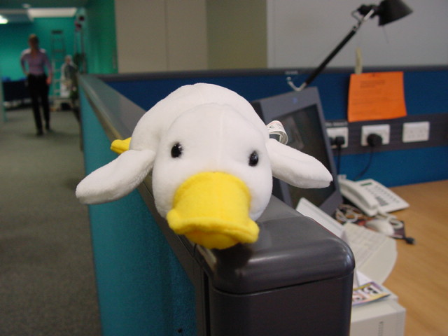
Notes:
I’m also interested in materiality more broadly – in particular the role of objects in identity construction and extension of selfhood at work. Desk project and now accountants project.
Mention the conflation issue again here – what are the similarities and differences between space, materiality, object? Where does the human body fit into this for example?

Slide 10
…knowingly or unknowingly, intentionally or unintentionally, we regard our possessions as parts of ourselves.
Belk (1988: 139)

Slide 11
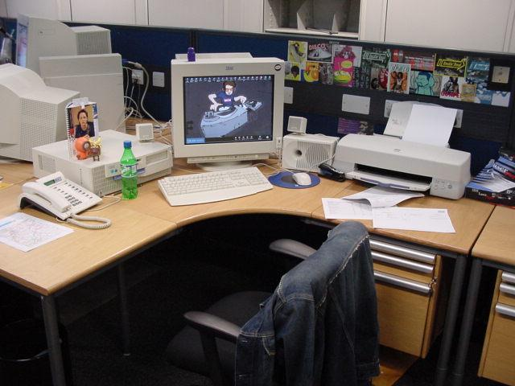

Slide 12
…employees must decide which aspects of the self belong to the domain of work and which belong elsewhere. in these ongoing negotiations self may be extended, but it may also be retracted and hidden. furthermore, although possessions can serve to stabilize the self, they also facilitate shifting among various self-aspects in response to workplace events.
Tian & Belk (2005: 297)

Slide 13
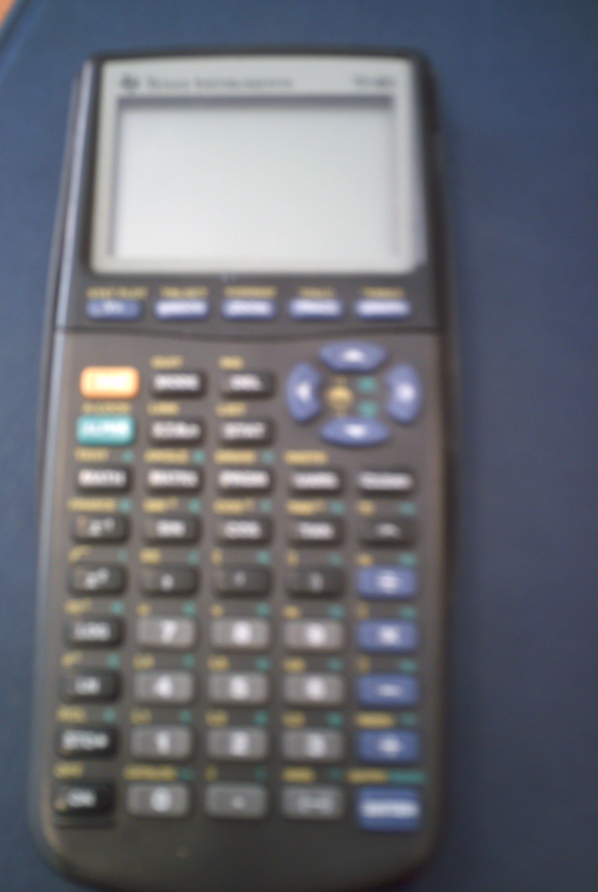
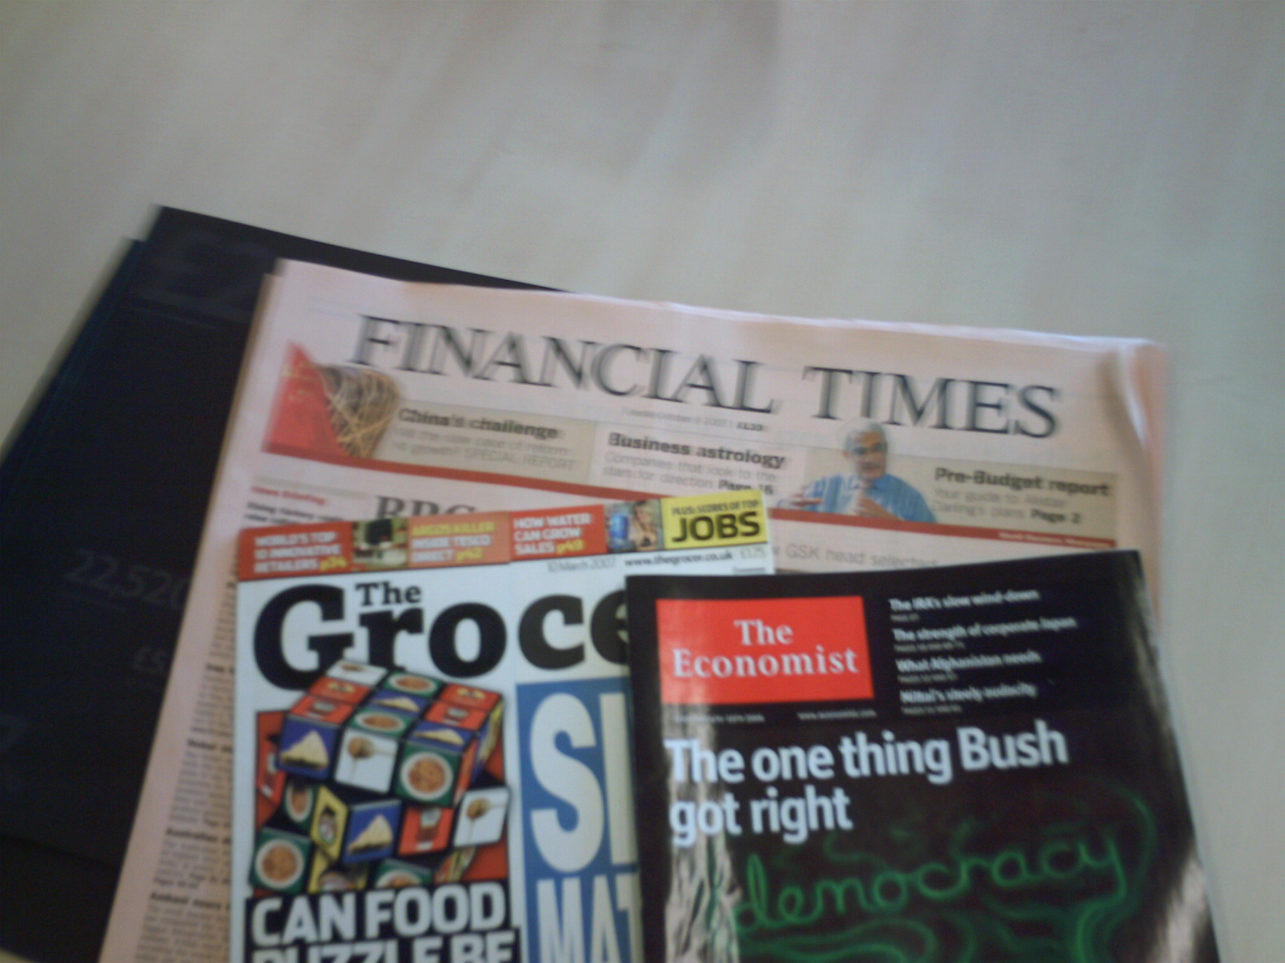
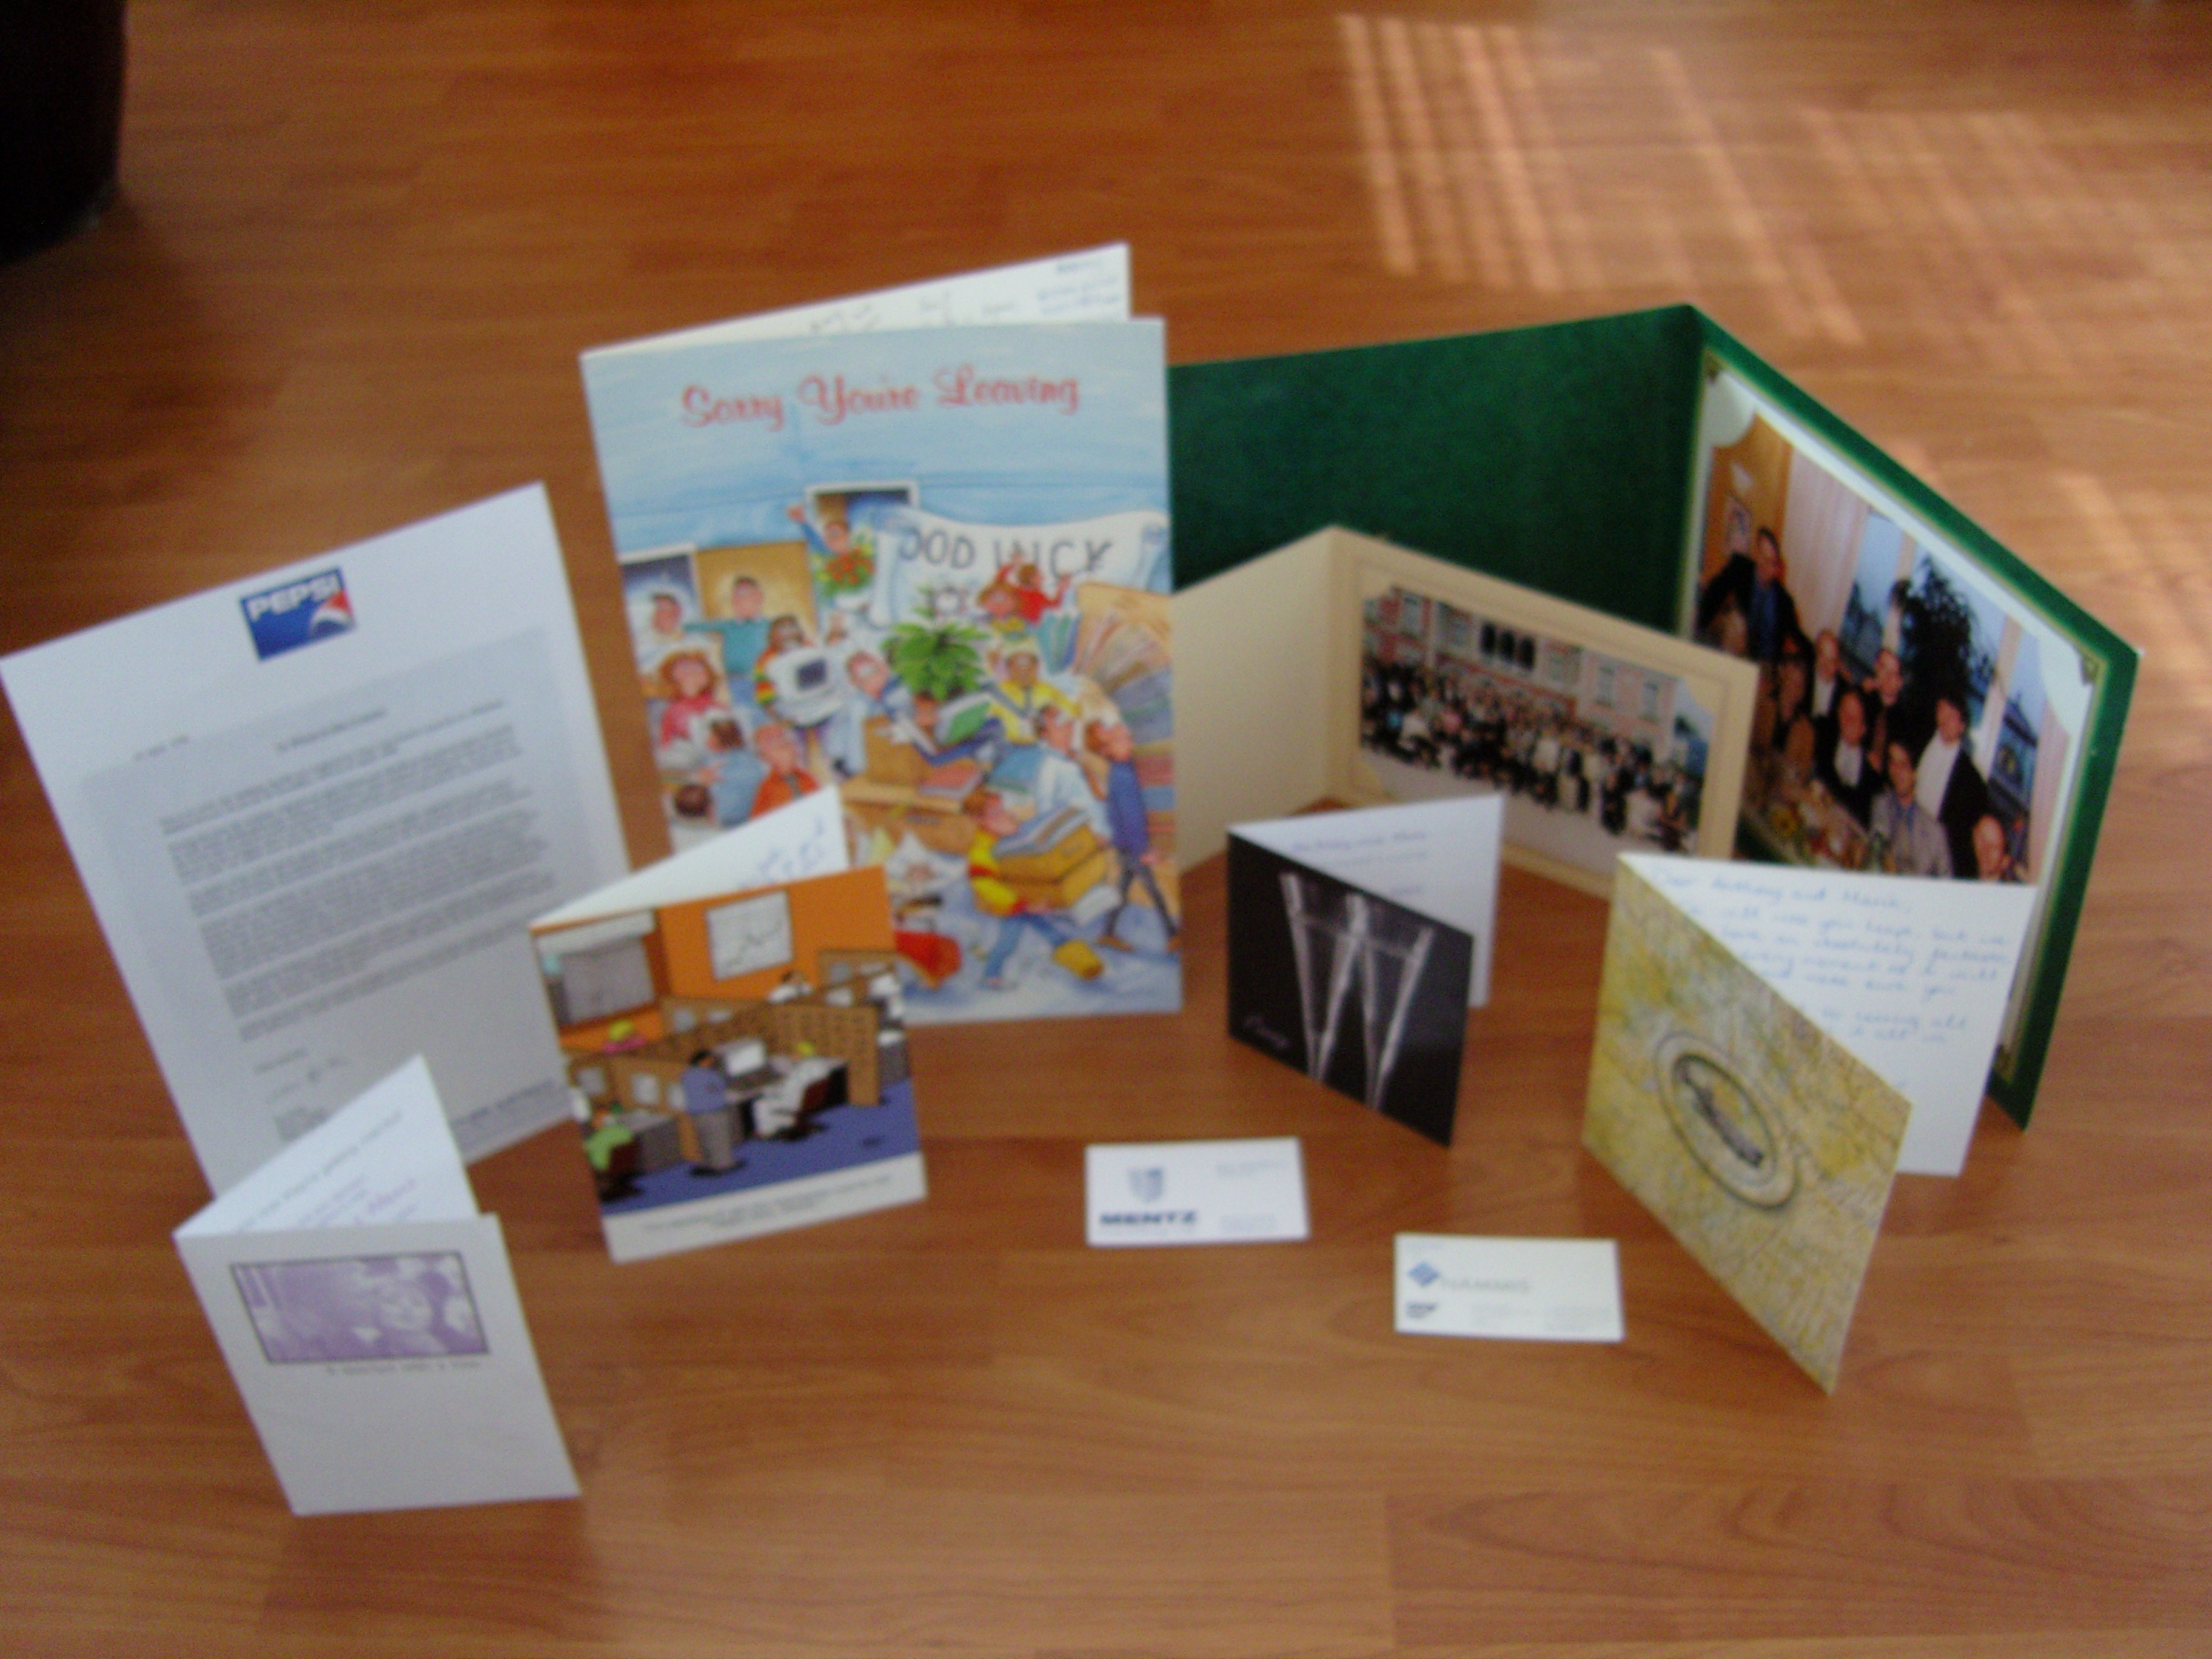
Accountants and professional identity

Slide 14
…objects look back, and their incoming gaze tells me who I am. our sense of self is like a television station always going out of focus, and we tune and clarify ourselves by seeing. everything from our wives and husbands, to our shoes and grass in the park looks back and tells us who we are
Elkins (1996: 86)
Notes:
More than this almost functional role of objects - although fascinating and well explicated in literature on material culture - dress, adornment, possessions etc. Also about the role of the material world in constructing us and shaping our identities as we move through different spaces and orient ourselves to different objects…
Link to Alison’s comment on Monika and jerzy’s paper yesterday about space defining us.

Slide 15
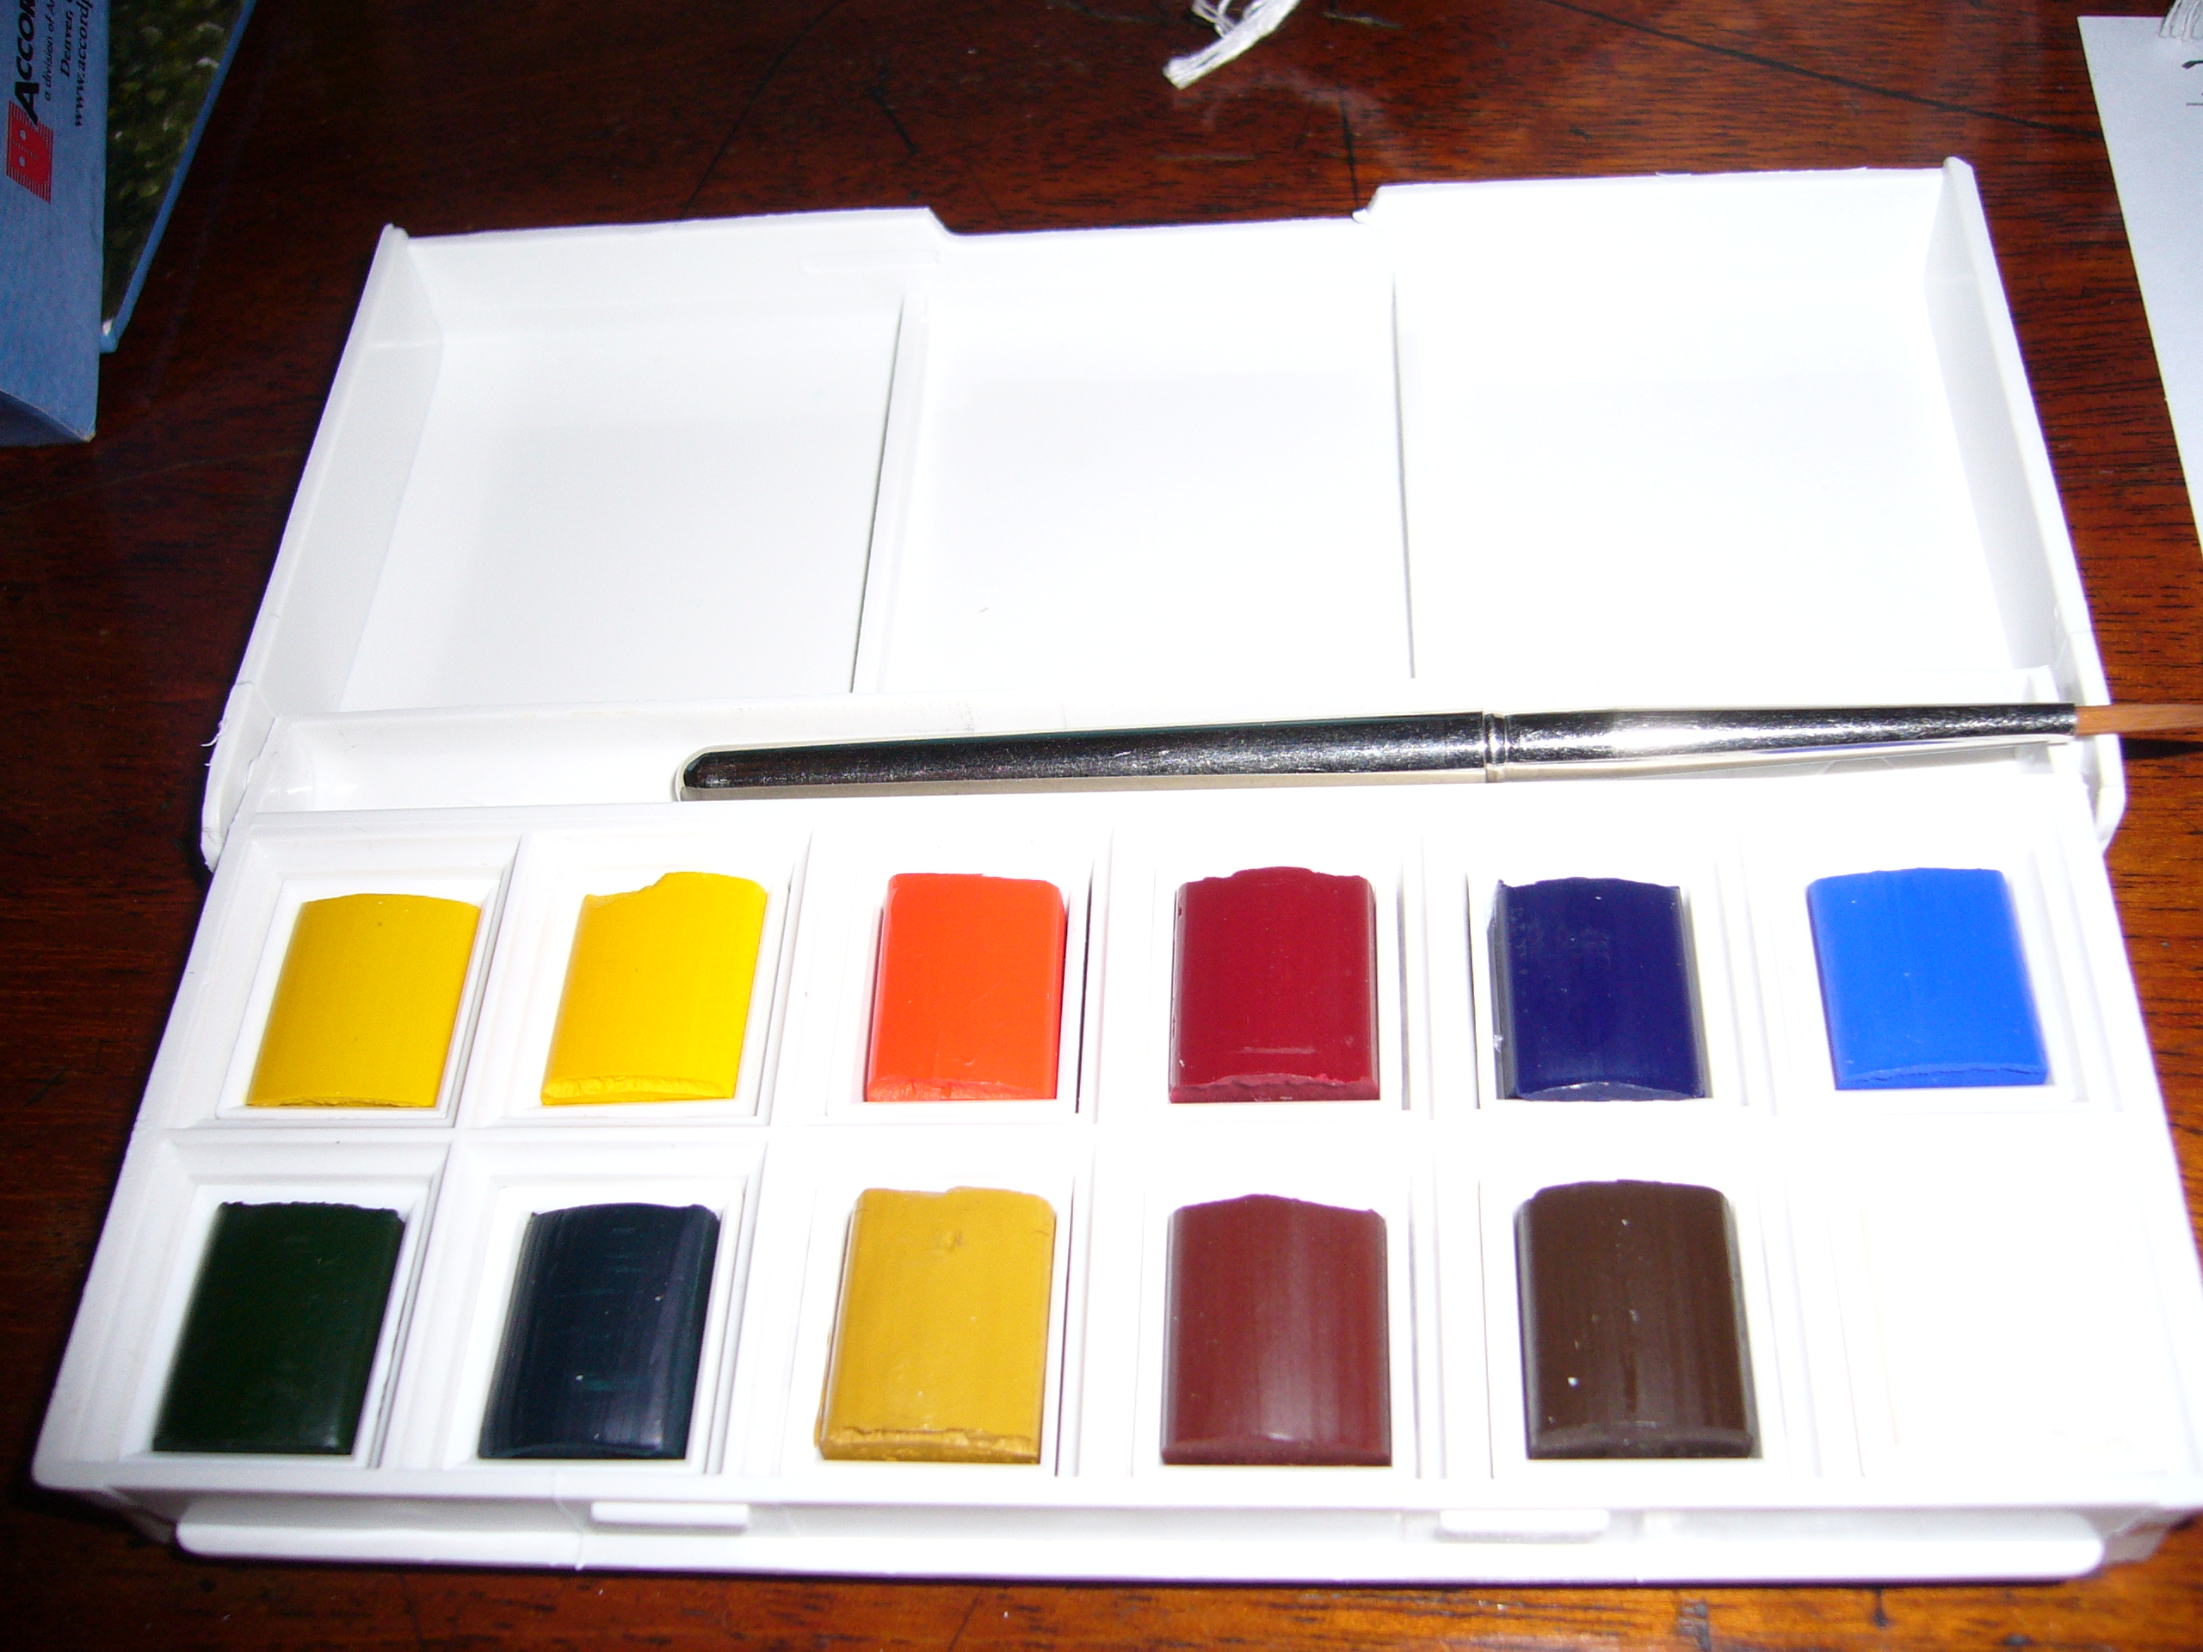

Slide 16
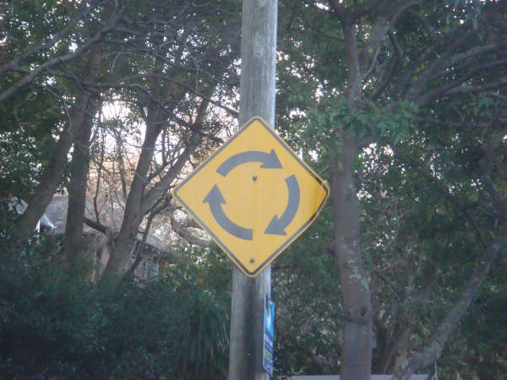

Slide 17
…rather than accepting that meanings are fundamentally separate from their material manifestations (signifier v. signified, word v. referent, etc.) the aim is to explore the consequences of an apparently counter-intuitive possibility: that things might be treated as sui generis meanings…. for in the image put forward, meanings are not ‘carried’ by things but are identical to them.
Henare et al. (2001: 3-4) original emphasis
Notes:
Radical essentialism - postmodernity has ignored the object concrete materiality (also argument made by Karen and Gibson)

Slide 18
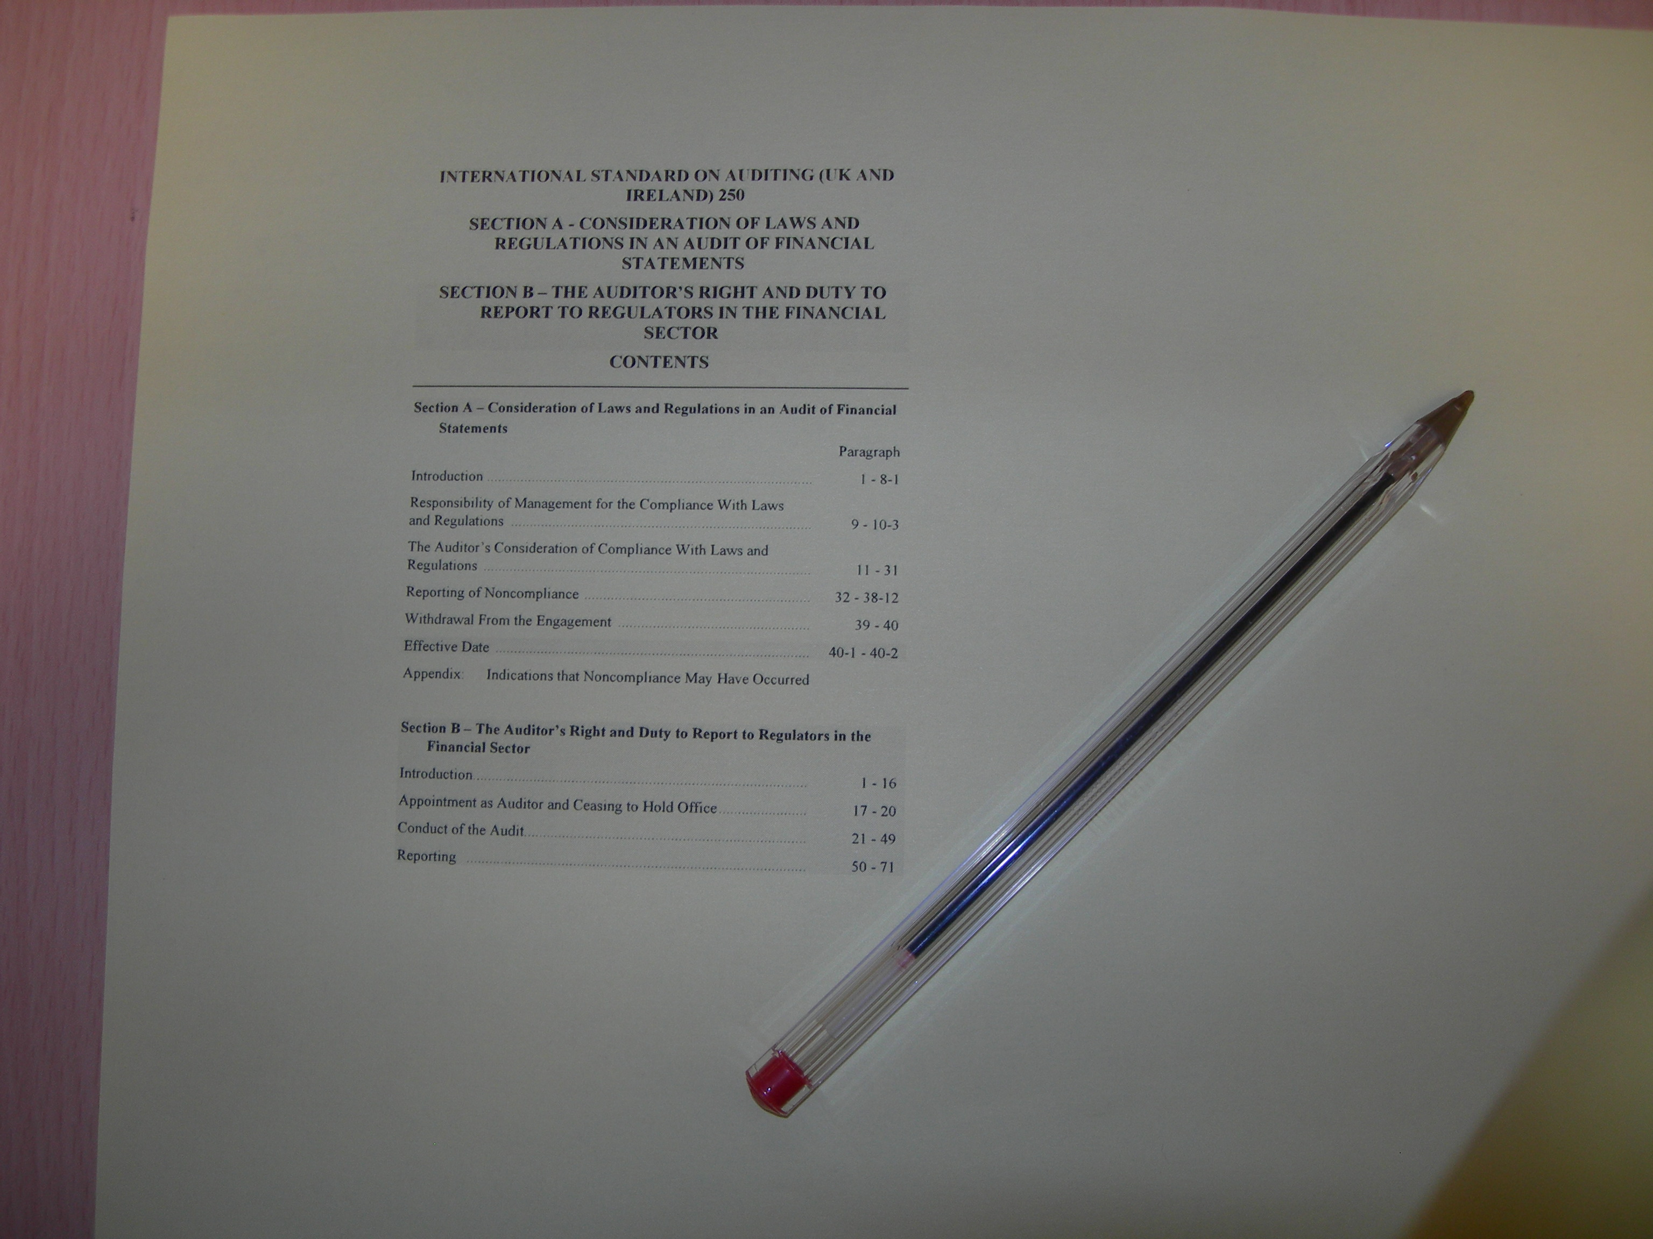

Slide 19
Activity part 2:
Reflecting on the process as a research participant:
How did the process feel?
How easy/hard was it to take the photos?
How did you go about doing it?
How did it feel to be interviewed about your pictures?
Gather your notes together and be ready to feed back to the group.

Slide 20
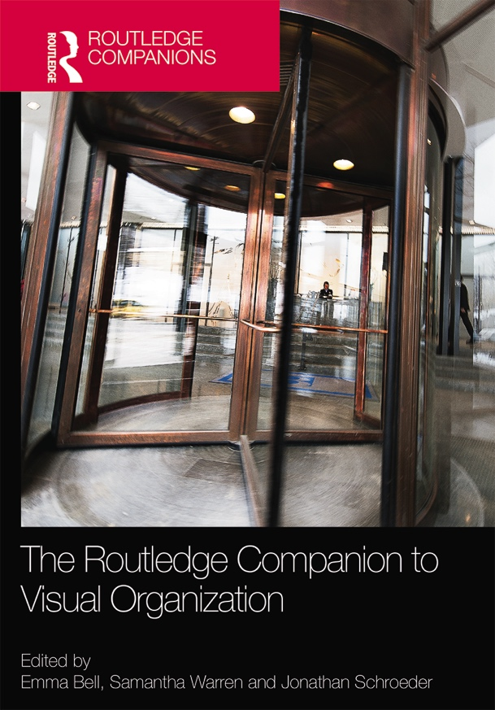
Photography as visual research practice
*Meyer et al. (2013)
Dialogic approaches*
Archaeological approaches*
Visualising data
Video and film making?
Image as data
Photography
Drawing/ arts
Dreamwork
Mapping
Rich pictures
Semiotics
Content analysis
Documentary
Bell et. al (2014) The Routledge Companion to Visual Organization

Slide 21
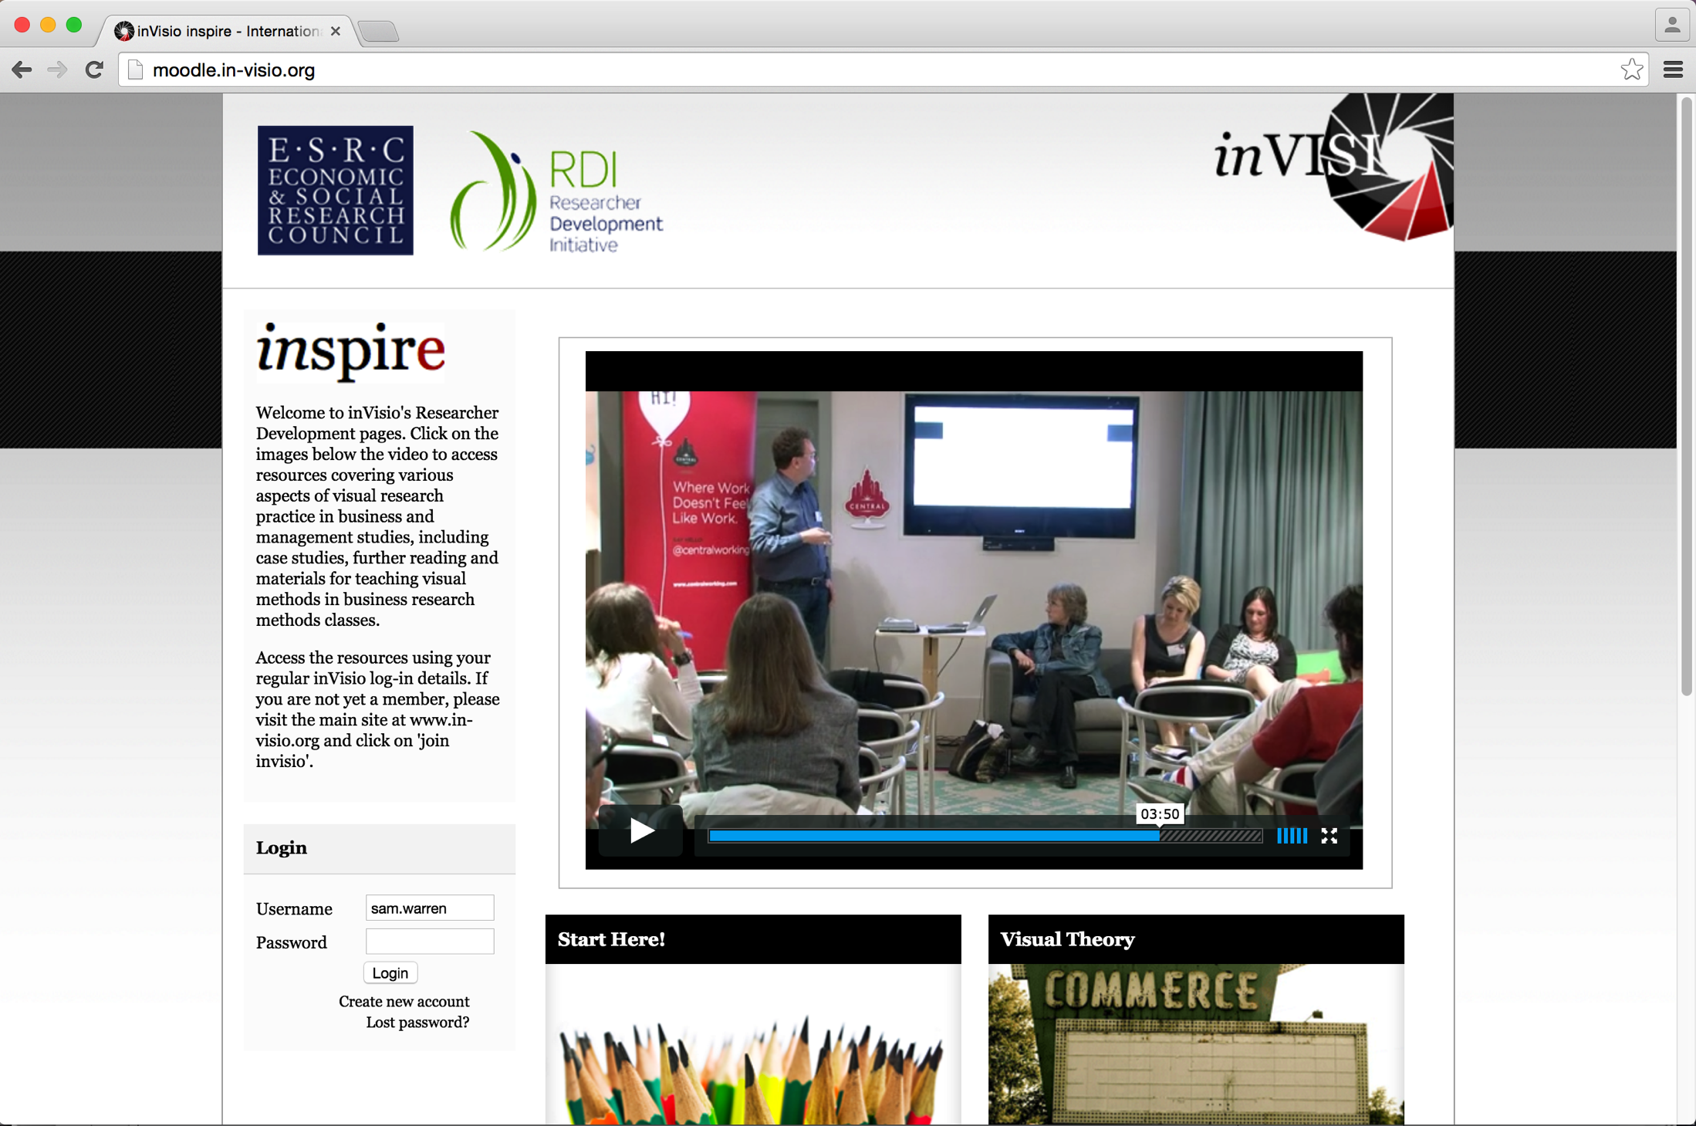
“…the camera is the ideal arm of consciousness in its acquisitive mood.” Sontag 1979: 3-4

Slide 22
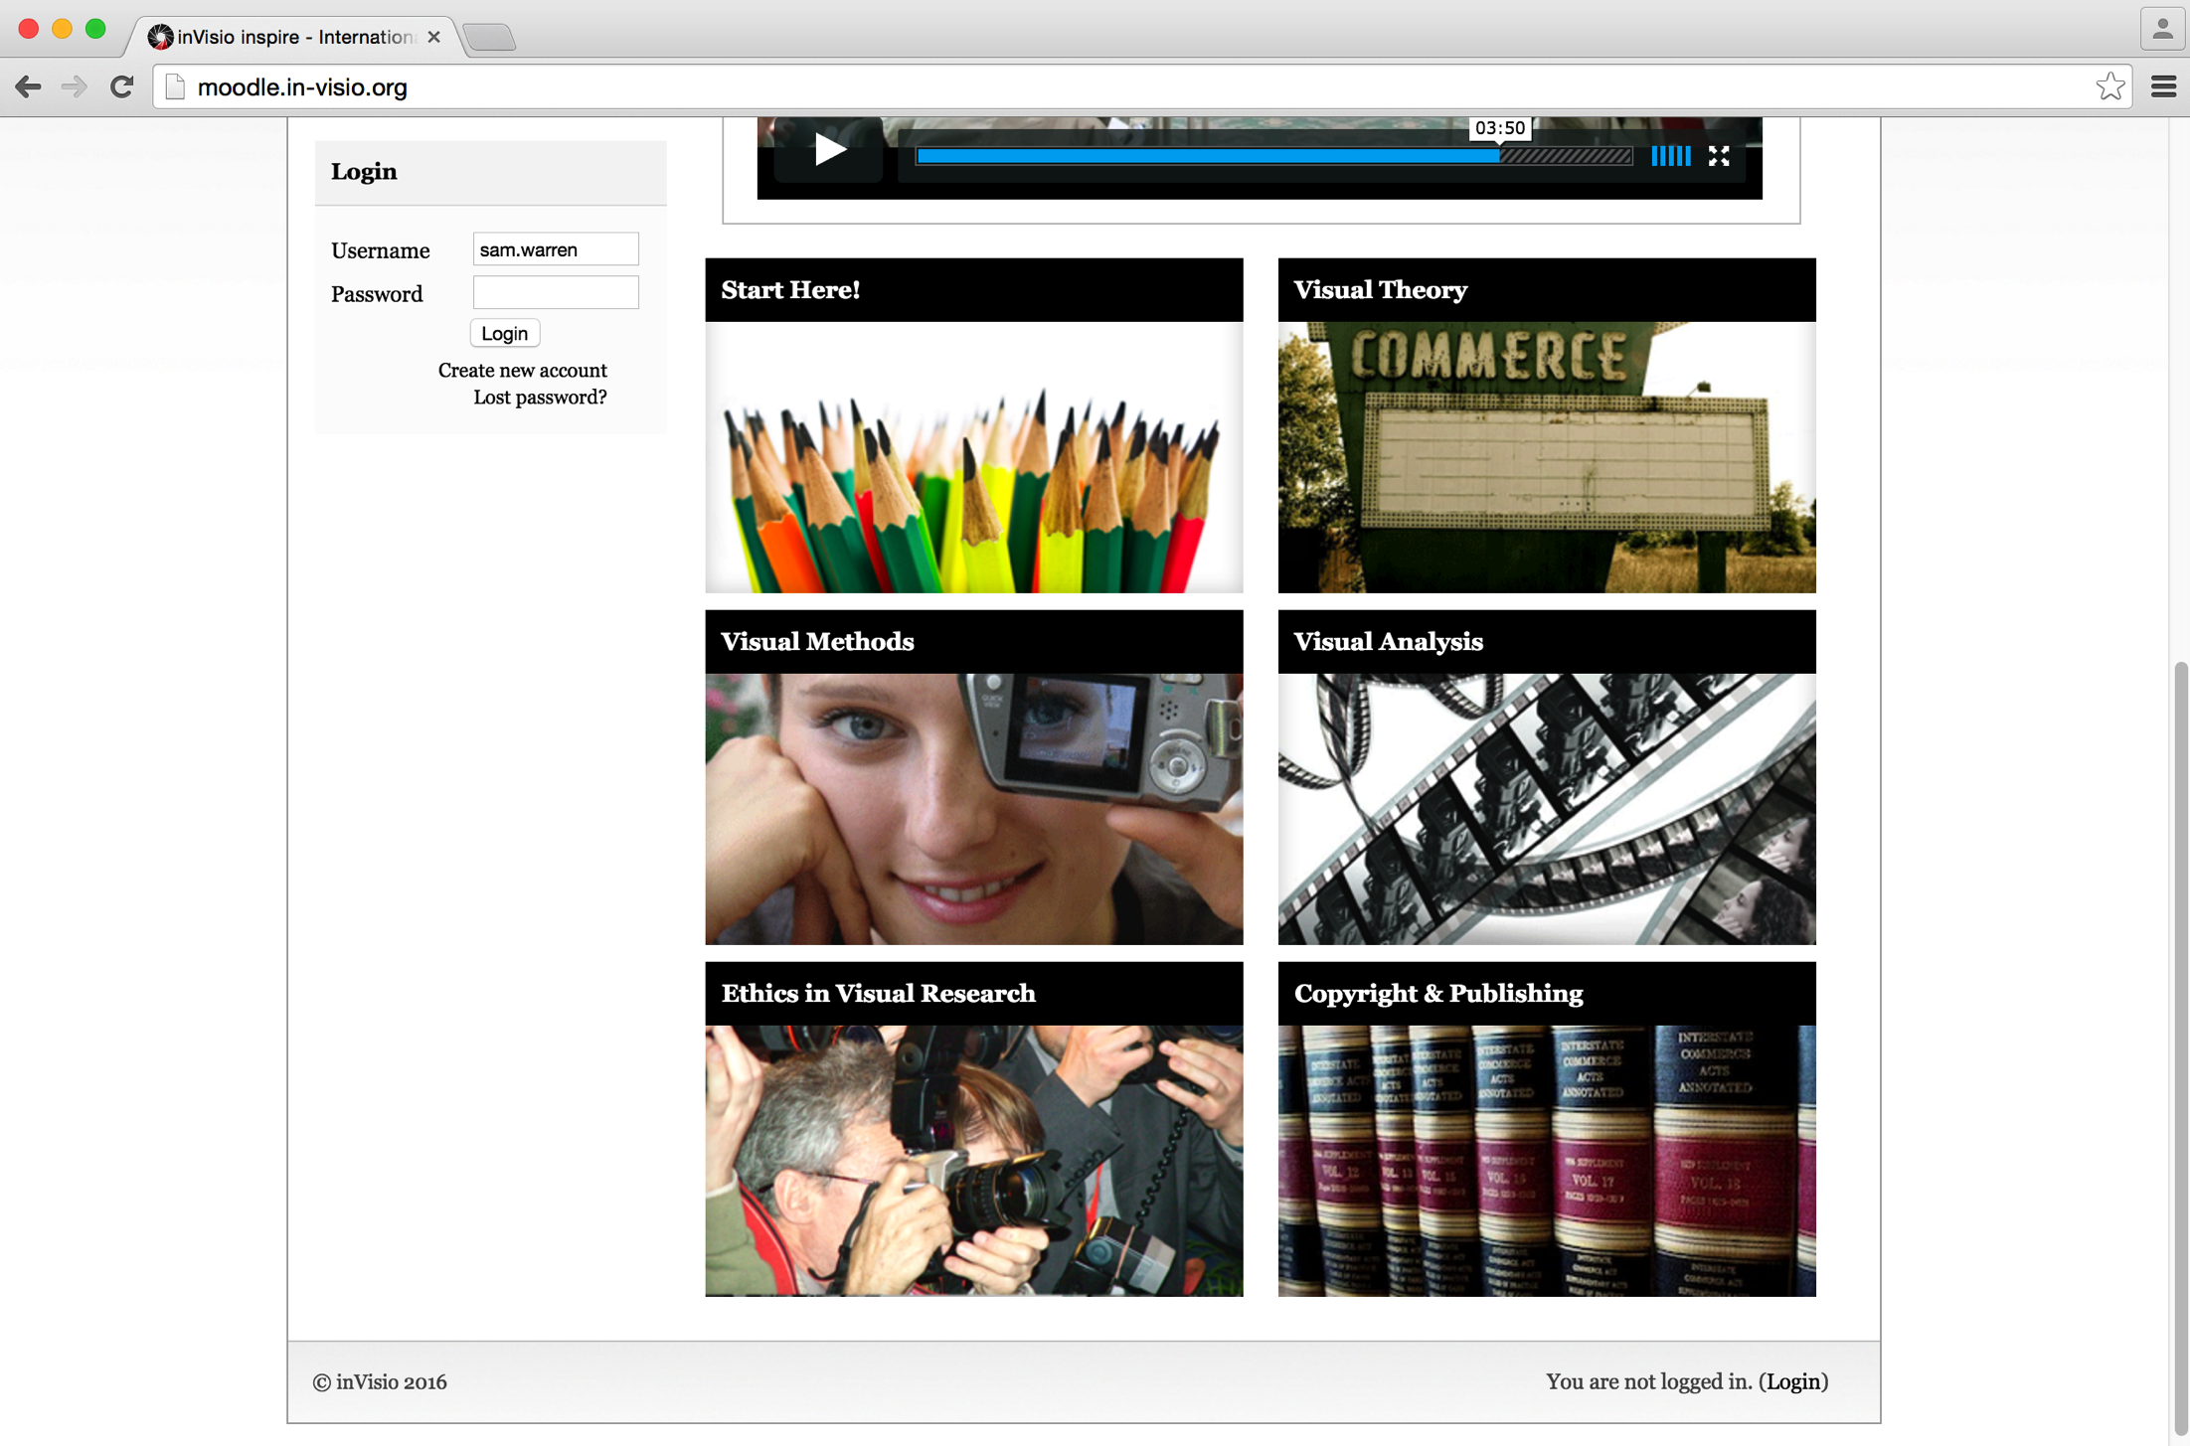

Slide 23
Types of visual research
Visualising data
Video and film making?
Image as data
Photography
Semiotics
Content analysis
Documentary

Slide 24
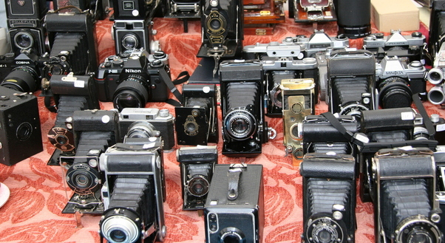
Photography’s heritage as a research method
Anthropology – ‘Meads’ (1942) Balinese tale’
Sociology (see Strangleman 2012)
Visual Sociology (IVSA) Visual Studies
Digital revolution
Rise of qualitative legitimacy
Ubiquity of photography
Changing role of photography in society

Slide 25
Activity 3:
Reflecting on the process as a researcher:
How did it feel to interview with photographs?
What kind of ‘data’ did you generate?
What (if anything) do you think the image added to a ‘normal’ interview?
Discuss in your small groups and be ready to feed back as before.

Slide 26
5 summary themes:
Inventory
Subjectivity (removed observation)
Construction or reality?
Ownership
Focus
Sensation/ intangibles/ emotion

Slide 27
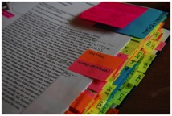
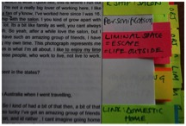
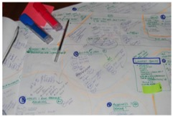
‘Where’ is the data?

Slide 28
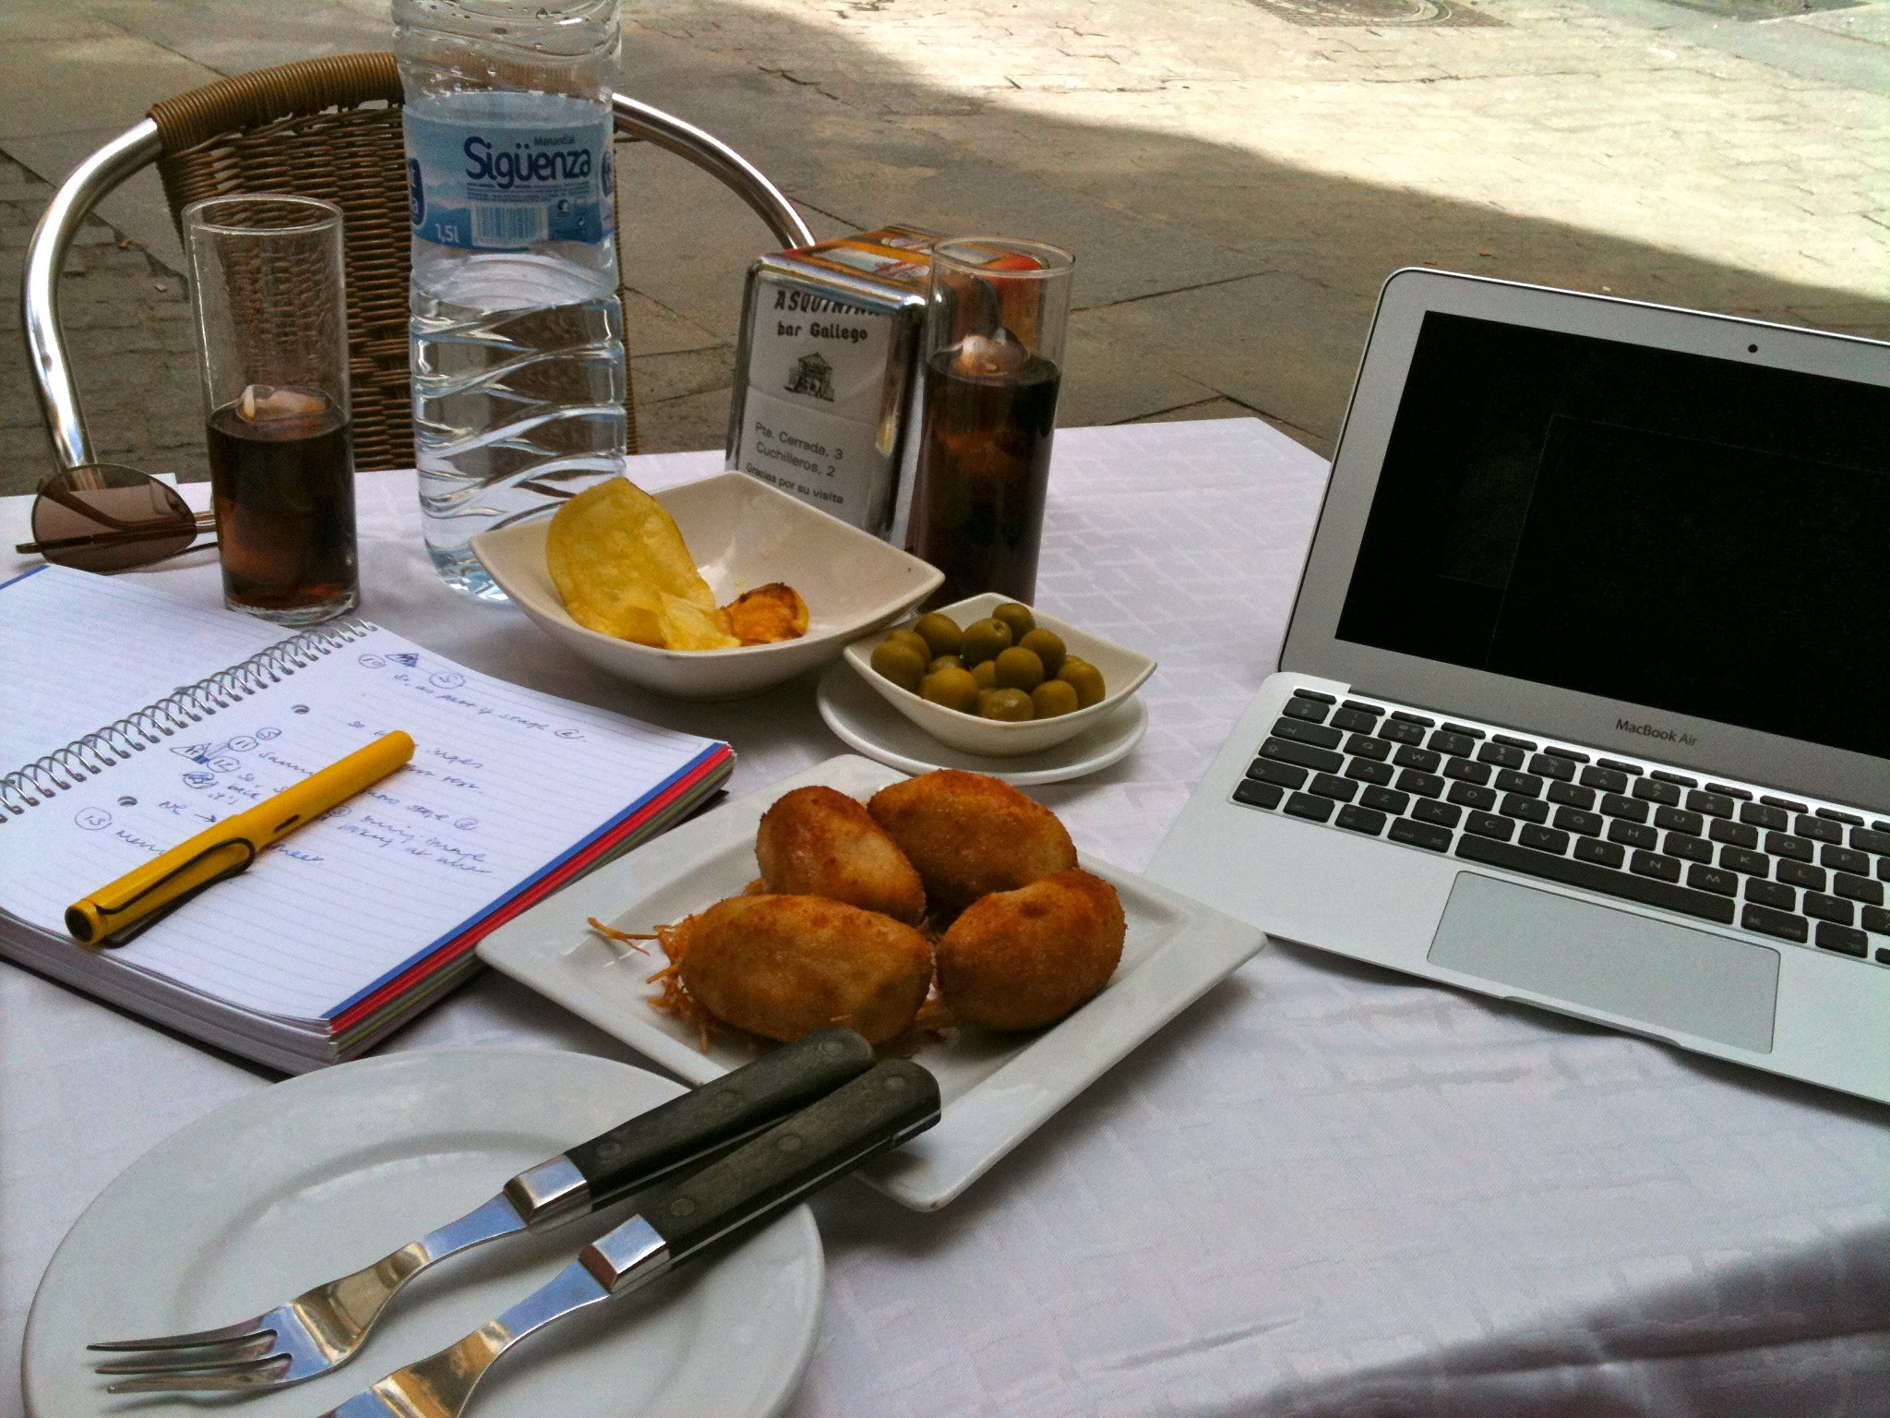
Thinking about analysis:
Very little out there on analysis of photographic methods, beyond reduction to text/ illustration
“Analytical blindness”
What more can the visual show us?
What patterns might we see across collections of photos?

Slide 29
An archaeological approach to the visual in research
Visual mode of meaning, communicates through the ‘silent speech’ of the material domain
Read images for clues about the culture/ society that produced it
(Kress and Van Leeuwen 1996)
“Sedimented social knowledge”
(Meyer et al. 2013)
Field-study photography is full of both active and less conscious decisions… could we read photographs in similar ways?
Ranciere 2006

Slide 30
An ethical commitment to participant ‘voice’
Keep the data ‘grounded’
Meaning is not ‘in’ the image – photographer needs to explain its significance
The point of these methods is to foreground participant voice – sometimes for political reasons
Need a context-sensitive method to keep these participant generated meanings
Wang and Burris (1997),
Wang and Redwood-Jones (2001),
Warren, (2005)
Drew and Guillemin (2014)

Slide 31
Grounded Visual Pattern Analysis
GVPA
Dialogic analysis
Grouping into image-sets
Ordering
Structured viewing:
symbolic
compositional
Theorising

Slide 32
Activity 4:
Using the blu-tac, stick your photos up on the classroom wall so they make one big montage.
Now stand back and look at them all!
Refer to the slide on ‘structured viewing’ and offer your thoughts…

Slide 33
Grounded Visual Pattern Analysis (GVPA)
Stage
4(i)
Structured viewing (Step 4):
Symbolic
What are the material objects and spaces that photographer(s) have used to communicate the dialogic meaning?
Compositional
How does the photographer situate themselves in relation to the material environment in order to communicate through it?

Slide 34
Grounded Visual Pattern Analysis
GVPA
Theorising (step 5)
What does the visual patterning add to our understanding of the data we generated through the photo-interviews?

